Slide 1



Sponsored by
Modeling, Estimation and Control Conference 2021
(Austin, TX, October 2021)

Slide 2

Sponsored by
Modeling, Estimation and Control Conference 2021
(Austin, TX, October 2021)

Slide 3
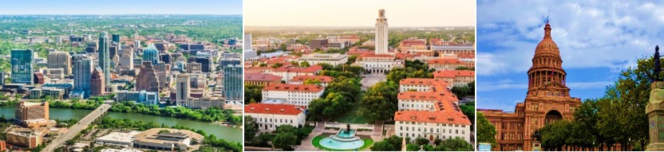

Modeling, Estimation and Control Conference 2021
(Austin, TX, October 2021)

Slide 4




